Slide 1
INFS 774 Big Data Analytics
Week 9

Slide 2
Spark tools

Slide 3
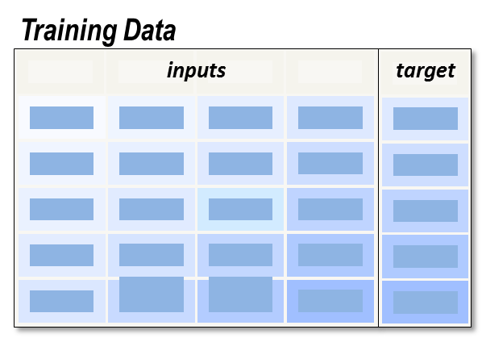
Supervised learning

Slide 4
Types of supervised learning
Classification (The target/dependent variable is categorical)
Regression (The target/dependent variable contains real-valued numbers)

Slide 5
STEP 1
Exploration

Slide 6
1.1 Univariate analysis
Issue | Method
Unreasonable, false values | Basic stats such as mean standard deviation, max, min, percentiles. Histogram
Missing values | Remove if at least +95% values are missing

Slide 7
1.2. Bi-Variate Analysis
BEYOND LINEAR CORRELATIONS: A REAL CASE FROM ONLINE SUB-CHANNEL OPTIMIZATIONS
Business problems: In order to establish the “Halo Effect” of Direct TV on online application, the Amex team studied the correlation between daily DRTV impressions on the one hand, and online applications on the other hand
A quick analysis of the scatterplot (daily date points throughout 2007) shows no linear correlation between the 2
A quick conclusion was that DRTV does not drive for web applications
Further analysis with a more flexible tool revealed 2 modes:
When DRTV impressions were < 30MM/day online applications increase with DRTV impressions at the rate of YY
Beyond a certain DRTV impression volume; the correlation is negative

Slide 8
STEP 2
MODIFICATION

Slide 9
2.1. Categorical and nominal variable Coding
Level
D_{A} D_{B} D_{C} D_{D} D_{E} D_{F} D_{G} D_{H}
D_{I}
A
1 0 0 0 0 0 0 0
0
B
0 1 0 0 0 0 0 0
0
C
0 0 1 0 0 0 0 0
0
D
0
0 0 0 1 0 0 0 0
E
0
0 0 0 0 1 0 0 0
F
0
0 0 0 0 0 1 0 0
G
0
0 0 0 0 0 0 1 0
H
0
0 0 0 0 0 0 0 1
I
1
0 0 0 0 0 0 0 0
...

Slide 10
Coding Redundancy
Level
D_{I}
D_{A} D_{B} D_{C} D_{D} D_{E} D_{F} D_{G} D_{H}
D_{I}
A
0
1 0 0 0 0 0 0 0
0
B
0
0 1 0 0 0 0 0 0
0
C
0
0 0 1 0 0 0 0 0
0
D
0
0 0 0 1 0 0 0 0
0
E
0
0 0 0 0 1 0 0 0
0
F
0
0 0 0 0 0 1 0 0
0
G
0
0 0 0 0 0 0 1 0
0
H
0
0 0 0 0 0 0 0 1
0
I
0 0 0 0 0 0 0 0
1
1
...

Slide 11
2.2. Missing Values Imputation
Training Data
inputs
target
Problem 1: Training data cases with missing values on inputs used by a regression model are ignored.
...

Slide 12
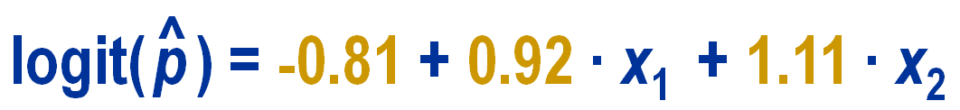
Missing Values and Regression Modeling
Training Data
inputs
target
Consequence: Missing values can significantly reduce your amount of training data for regression modeling!
...

Slide 13
Missing Value Imputation
Independent variable type | Method
Categorical (including binary), Nominal | Treat missing as a category, dummy coding
Ordinal (levels) | Treat missing as a new category dummy coding
Ordinal (count), Continuous | Mean value and add an indicator variable

Slide 14
Step 3 Data splitting

Slide 15
Validation

Slide 16
Uses of validation
Select models.
Select variables.
Tune algorithm hyperparameter.

Slide 17
Test dataset
The test set is used for estimating final model (the model which was selected by selection process) prediction error.
Why?: Validation dataset is often “contaminated” during selection/tuning process

Slide 18
Step 4 Variable selection
ChiSquareSelector

Slide 19
Step 5 Model building
Problem Type | Supported Methods
Binary Classification | linear SVMs, logistic regression, decision trees, random forests, gradient-boosted trees, naive Bayes
Multiclass Classification | logistic regression, decision trees, random forests, naive Bayes
Regression | linear least squares, Lasso, ridge regression, decision trees, random forests, gradient-boosted trees, isotonic regression

Slide 20
Step 6 Model assessment

Slide 21


Assessing linear regression models
We compute the Residual Standard Error (or Root-mean-squared error)
These measures work for all regression based algorithms
R-squared of fraction of variance explained is
The proportion of variation in the dependent variable that is accounted for (or explained) by the regression model. R² lies between 0 and 1.

Slide 22
Model assessment of classification problems
These measures can be used for classification based algorithms (e.g., logistic regression, svm, neural networks, etc.)
Recall (critical for class imbalance)
There are other commonly used measures (such as roc curve, KS statistic).

Slide 23
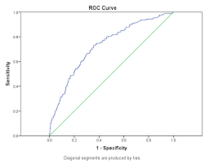
Model assessment of classification problems

